Slide 1
SeeingIsBusLeaving
hardware hacking sustainability
By: Daniel Lu, Jacob Gordon, Oleg Lukyanenko

Slide 2
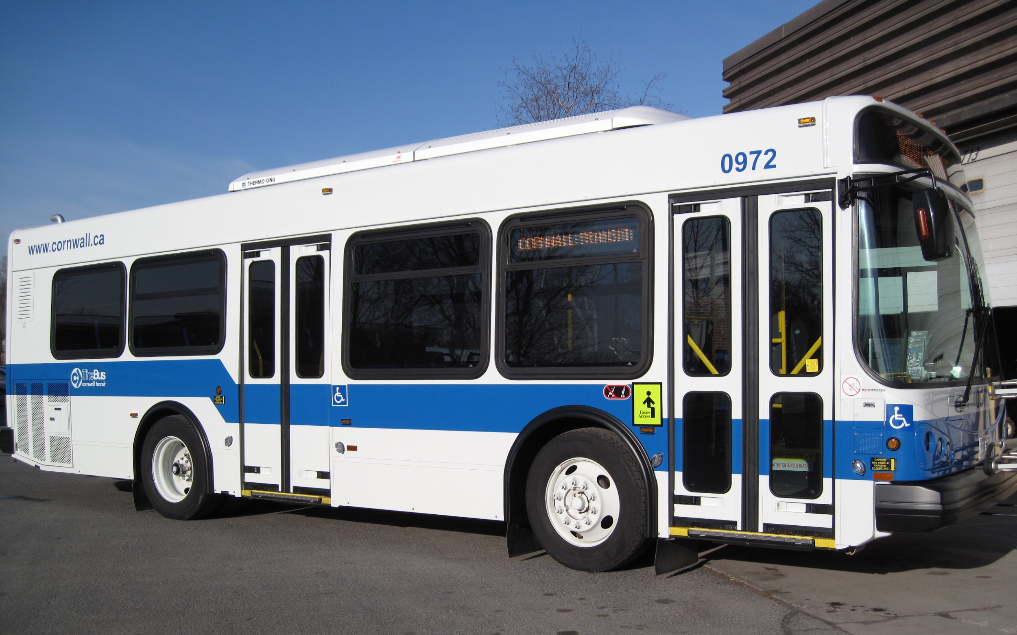
Sustainability Issue: Public Transport
More people using public transport reduces cars on the road
Many buses are running with almost no riders
Mobile scheduling systems are not entirely useful for low income individuals, and are not intuitive or convenient to use

Slide 3
Why Aren’t People Using Public Transit?
Long wait time
Buses are not consistent with their schedule
Hard to know when the next bus is arriving
^This is the one we can fix

Slide 4

Current and Obvious Solutions
Having a screen at every bus stop is too expensive and too risky to implement
Current solutions require customer to text or call for the bus schedule
Not everyone has access to data plans to check the schedule

Slide 5
Our Solution
Instead of a screen, we overlay bus route maps with our system
LEDs are laid at bus stops
We use GSM signals (wireless phone signals) to transmit data fast
Live updates at each bus stop for each relevant bus

Slide 6
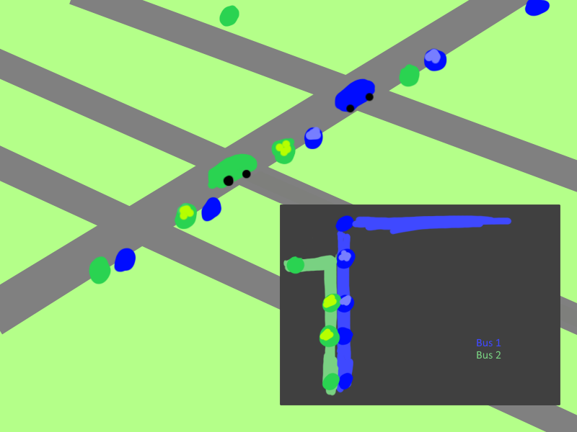

Slide 7
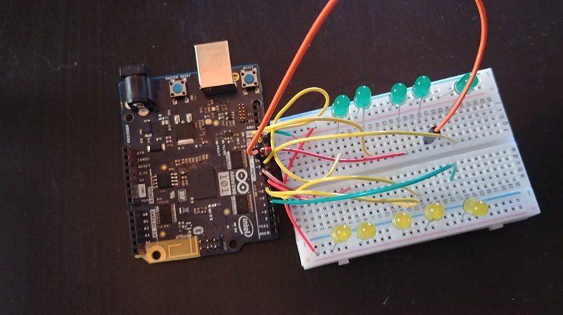
Our Solution - Demo
Our solution is a circuit of LED lights, each one placed at a bus stop on a map of the bus’ route, with the path between the 2 currently lit LEDs representing the current location of the bus
Communicates wirelessly
POC for SMS data position reports

Slide 8
Thank You

